Slide 1
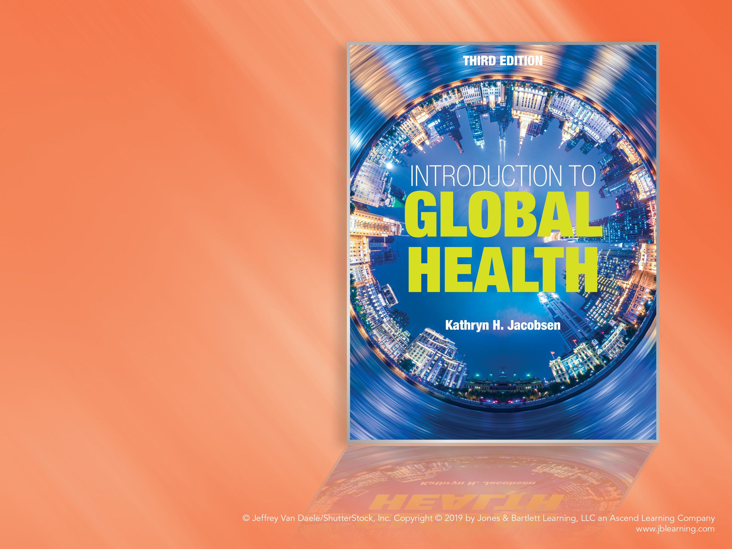
Chapter 10
Malaria and Neglected Tropical Diseases (NTDs)

Slide 2
Malaria, NTDs, and Global Health
10.1

Slide 3
Neglected Tropical Diseases
Malaria has been the target of international public health efforts since the late 1800s, when scientists first discovered that the malaria parasite was transmitted to humans through the bites of infected mosquitoes.
Most countries where malaria still occurs are places where other tropical and parasitic diseases are also common.

Slide 4
Neglected Tropical Diseases (cont’d)
Neglected tropical diseases (NTDs) = infectious diseases that primarily affect the poorest regions of the world and have not historically been a priority for funding agencies, pharmaceutical companies, or global policymakers.
  Neglected does not mean infrequent: NTDs affect more than 1 in 6 of the world’s population.
Sustainable Development Goals: “end the epidemics of AIDS, TB, malaria, and neglected tropical diseases (NTDs)” by 2030 (SDG 3.3).
  Millennium Development Goal: “combat HIV/AIDS, malaria, and other diseases” (MDG 6).

Slide 5
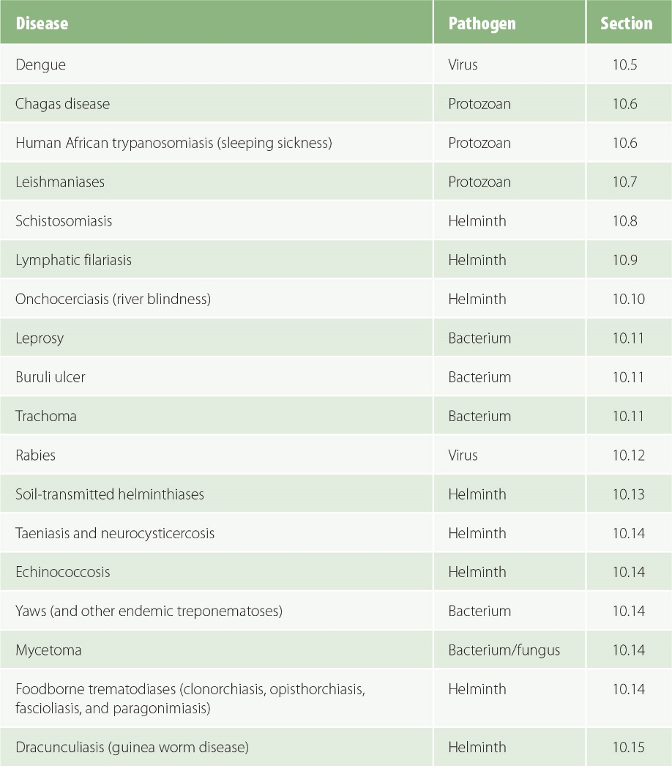
Figure 10-1
Data from Investing to overcome the global impact of neglected tropical diseases: 3rd WHO report on neglected tropical diseases. Geneva: WHO; 2015.
Neglected tropical diseases recognized by the WHO.

Slide 6
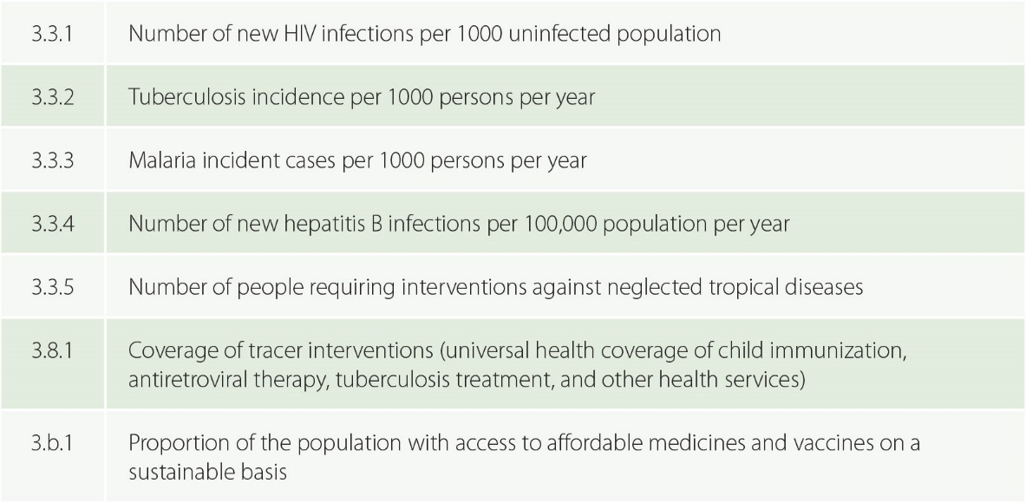
Figure 10-2
Data from United Nations Economic and Social Council. Report of the Inter-Agency and Expert Group on Sustainable Development Goal Indicators (E/CN.3/2016/2/Rev.1). New York: UN; 2016.
Examples of Sustainable Development Goals (SDGs) targets focused on infectious diseases.

Slide 7
Parasites: Protozoa and Helminths
10.2

Slide 8
Parasites
Parasite = a eukaryotic organism that survives by living in or on a host organism.
Two types of disease-causing parasites: protozoa and helminths.
Protozoan = a single-celled organism that has animal-like characteristics and often lives in water.
  Classified based on how they move and on the characteristics of their lifecycles: amoeba, flagellates, ciliates, sporozoa.
  Malaria is a protozoan.
Helminth = a multicellular worm that lives inside the body of its host (endoparasitic).

Slide 9
Helminths
Helminths are classified by shape as well as by their lifecycles.
Nematode = a cylindrical roundworm.
Cestode = a tapeworm.
Trematode = a fluke (flatworm).
Intermediate host = an animal host in which an immature parasite, a larva, develops but does not reach sexual maturity.
Definitive host = the animal host in which a parasite reaches sexual maturity and reproduces.

Slide 10
Malaria
10.3

Slide 11
Plasmodium
Malaria = a parasitic infection with protozoa from the Plasmodium species.
There are five types of Plasmodium known to cause human infection.
Falciparum malaria is generally the most serious infection.
  Nearly 90% of all malaria cases and deaths occur in sub-Saharan Africa, and nearly 99% of these cases are caused by P. falciparum.
  Outside of sub-Saharan Africa, about half of cases are caused by P. falciparum and half by P. vivax.
The parasites that cause malaria have a very complex lifecycle that involves developmental stages in both humans and mosquitoes.

Slide 12
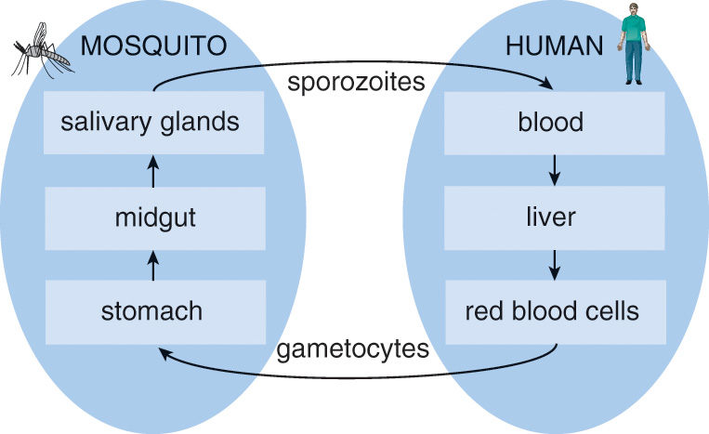
Figure 10-3
Lifecycle of the Plasmodium parasites that cause malaria.

Slide 13
Symptoms
Malaria usually presents with cyclic fevers, headaches, joint pain, and other symptoms of influenza-like illnesses, but it can cause organ failure and death.
Malaria can cause weeks or even months of illness due to relapses and fatigue.
  Reinfection is common, and in many tropical areas the average child has several bouts of malaria each year.

Slide 14
Symptoms (cont’d)
Children and pregnant women are most at risk for severe complications and death.
  Malarial anemia = the destruction of so many red blood cells that the body cannot adequately transport oxygen through the bloodstream.
  Cerebral malaria = malaria that causes seizures and coma (impaired consciousness).
  Babies born to mothers with malaria are at increased risk of low birthweight and other birth complications.

Slide 15
Malaria Epidemiology
More than 200 million cases of malaria occurred worldwide in 2015, and about 450,000 people died from the disease.
The number of cases in 2015 was about one-third lower than the number of cases in 2000.
The number of deaths decreased by nearly half during those 15 years.
The number of deaths in children less than 5 years old decreased from about 725,000 to 300,000.
The percentage of people who die from malaria who are young children decreased from 85% to about 70%.
These improvements are attributed to the scale-up of several malaria prevention and treatment interventions.

Slide 16
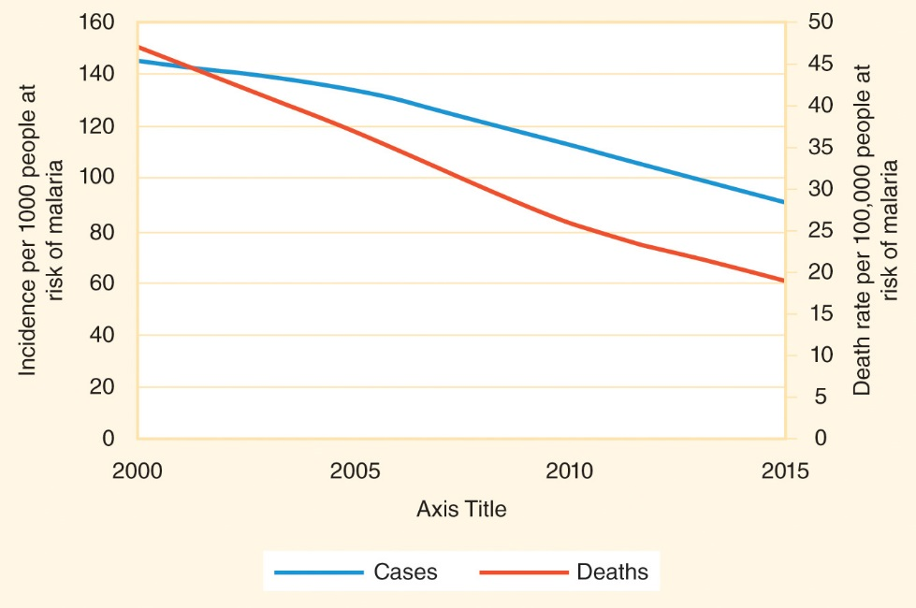
Figure 10-4
Data from World malaria report 2015. Geneva: WHO; 2015.
Global malaria cases and deaths decreased significantly between 2000 and 2015.

Slide 17
Malaria Interventions
10.4

Slide 18
Malaria Interventions
The only way that humans contract malaria is by being bit by an infected mosquito, and the only way that mosquitoes become infected is by biting an infected human.
There are two key types of malaria control interventions:
  Reduce the likelihood of a human being bit by a mosquito.
  Treat people with malaria so that they regain health and so that mosquitoes that bite them will not contract malaria.

Slide 19
Malaria Treatment
Strains of malaria are becoming resistant to many of the drugs that used to be effective against it.
Treating infections with combinations of drugs slows the emergence of drug resistance.
  Malaria control experts strongly urge the use of artemisinin-based combination therapy (ACT) that combines at least two different antimalarial drugs (such as artemether plus lumefantrine or artesunate plus mefloquine), one of which is an artemisinin-based drug.
Treating only laboratory-confirmed cases (with a few exceptions) also prevents drug resistance from emerging.
  A rapid diagnostic test (RDT) can detect the presence of a pathogen or markers for a pathogen within 15 to 30 minutes.

Slide 20
Intermittent Preventive Treatment
Intermittent preventive treatment (IPT) = the use of “preventive chemotherapy” with anti-malarial medications in vulnerable people so that they maintain therapeutic drug levels in their blood during times of high risk for malaria.
IPT in pregnancy (IPTp) = the routine distribution of anti-malarial medications to all pregnant women who live in malaria-endemic countries, even if the women do not have symptoms of malaria at the time of treatment.
  Presumptive treatment for malaria with IPTp is effective at increasing the average birth weight and survival rates of babies born to women who receive the recommended doses.

Slide 21
Insecticide-Treated Net
Barriers between humans and mosquitoes prevent mosquito bites and interrupt the mosquito–human–mosquito transmission cycle.
Insecticide-treated net (ITN) = a mesh sheet dipped in insecticides and then hung over a bed to provide a barrier between sleeping humans and mosquitoes while also killing any mosquitoes that land on it.
  Most ITNs need to be re-dipped in pyrethroid insecticides every 6 months or so to maintain effectiveness.
  Long-lasting insecticidal net (LLIN) = an ITN that has been impregnated with a pesticide that remains effective for 2 years or longer before requiring retreatment.

Slide 22
Insecticide-Treated Net (cont’d)
ITNs significantly reduce child mortality in malaria-endemic areas when they are used consistently.
  The proportion of young children in sub-Saharan Africa who sleep under an ITN increased significantly since 2000.
  About two-thirds of the reduction in malaria cases between 2000 and 2015 are attributed to scaled-up use of ITNs.
  It is also important for malaria patients to stay under a bednet so mosquitoes cannot bite them and become carriers of malaria.

Slide 23
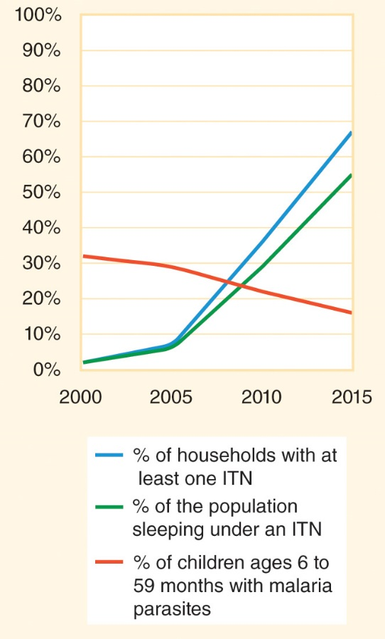
Figure 10-5
Data from World malaria report 2015. Geneva: WHO; 2015.
The percentage of under-5 children in sub-Saharan Africa who sleep under an insecticide-treated net (ITN) has increased rapidly.

Slide 24
Other Preventive Options
Wearing clothes that cover the arms and legs
Having screens or curtains cover the windows and doors of houses when possible
Using insect repellents like bug sprays, especially those that contain DEET (N,N-diethyl-m-toluamide)
Although travelers from nonendemic areas to places where malaria is endemic generally take prophylactic (preventive) antimalarial drugs, it is not realistic or healthy to encourage prophylactic use among people living in highly endemic areas.

Slide 25
Mosquito Control
Anopheles mosquitoes are the genus of mosquitoes that spread malaria.
The Global Malaria Eradication Programme (1995–1969) sprayed DDT (dichloro-diphenyl-trichloroethane) to kill malarial mosquitoes.
  DDT is a persistent organic pollutant (POP) that builds up in the food chain (killing birds and fish) when used outdoors in large quantities.
  DDT was banned in most countries by 2001.
  Small amounts of DDT used indoors seem to be harmless to humans and other animals and very effective at killing malaria-spreading mosquitoes.
  Use of the chemical is now limited but not banned.

Slide 26
Mosquito Control (cont’d)
Indoor residual spraying (IRS) = the application of long-lasting insecticides to walls and other surfaces where mosquitoes might rest, so that mosquitoes that land on those surfaces during the following 6 months or longer will absorb a lethal dose of the insecticidal chemical.

Slide 27
Dengue and Other Arboviruses
10.5

Slide 28
Arboviruses
Vectorborne infection = an arthropod-borne infection.
  Arthropod = an insect (such as mosquito, fly, or flea) or an arachnid (such as a spider, tick, or mite).
Cycle of infection = how an infectious agent passes between different species.
  Human–human–human cycle
  Vertebrate–vertebrate–human cycle
  Human–insect–human cycle (or an animal–insect–animal cycle that occasionally affects a human)
Arbovirus (arthropod-borne virus) = a virus transmitted to humans by an arthropod.

Slide 29
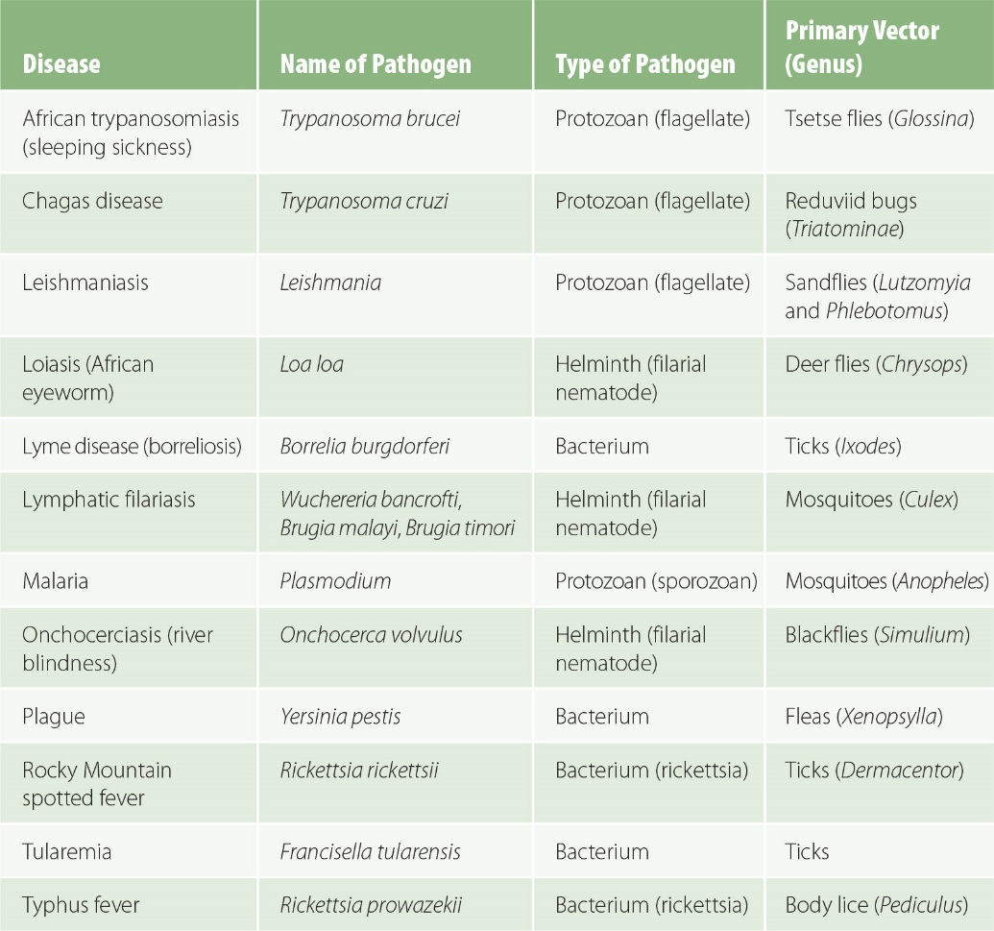
Figure 10-6
Examples of bacterial and parasitic vectorborne diseases.

Slide 30
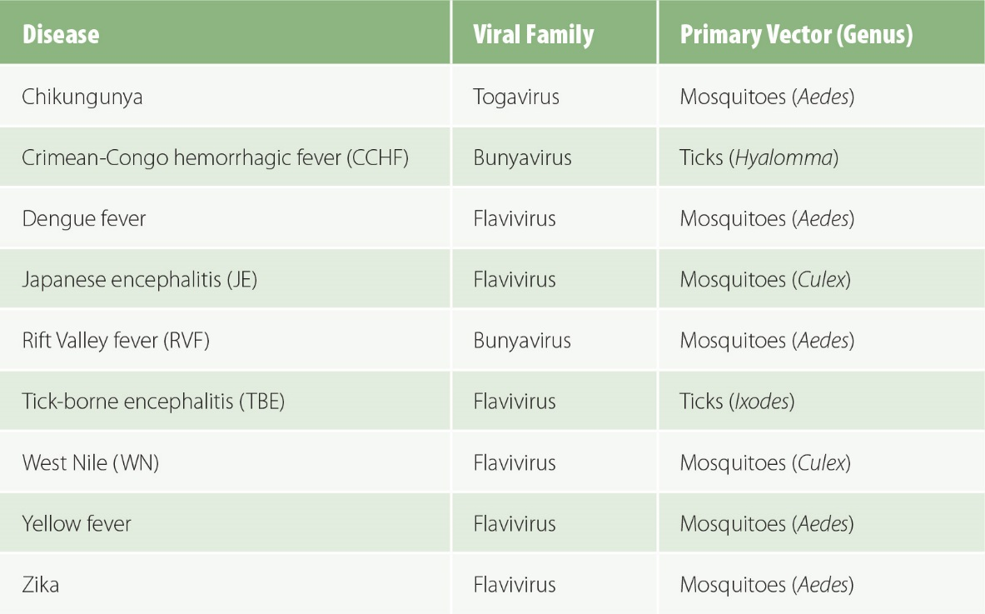
Figure 10-7
Examples of arboviral diseases.

Slide 31
Dengue
Dengue fever (DF) = an arbovirus spread by the bites of infected Aedes mosquitoes.
  Common symptoms: a high fever plus a severe headache and pain in the eyes, joints, muscles, and bones
  Risk of dengue hemorrhagic fever (DHF) and dengue shock syndrome (DSS)
About 100 million people become ill from dengue virus infections each year, with the heaviest burdens in South Asia, Southeast Asia, tropical South America and some parts of tropical sub-Saharan Africa.
A dengue vaccine must protect against all four serotypes of dengue virus (DENV).
  A dengue vaccine was licensed for the first time at the end of 2015, but it may be several years before it is widely available.

Slide 32
Flaviviruses
The dengue, yellow fever, Zika, West Nile, and JE viruses are all in the flavivirus genus of the flavivirus family.
Yellow fever (YF) = a disease named for the jaundice that turns the skin and eyes of victims yellow.
  About 1 in 20 people who contract the YF virus die from it, usually as a result of hemorrhagic fever.
  The International Health Regulations (IHR) mandate YF vaccination for travelers to and from places where outbreaks are occurring.
In 2015, a large outbreak of Zika virus in Brazil raised concerns about the links between ZIKV and birth defects.
  Microcephaly = an abnormally small head that is a sign of aberrant brain development.

Slide 33
Flaviviruses (cont’d)
West Nile virus (WNV) started circulating in the New York metropolitan area in 1999, and the infection quickly became endemic across the continental United States.
  Most people who become infected with WNV have no symptoms or only mild symptoms, but a small percentage (<1%) develop severe neurologic complications.
Outbreaks of Japanese encephalitis (JE) occur regularly in Asia and Oceania even though the infection is vaccine-preventable.

Slide 34
Other Arboviruses
Viruses from other families can also be arborviruses.
Rift valley fever (RVF) is a zoonosis that can cause outbreaks of pregnancy loss in livestock herds.
Chikungunya fever can cause long-term disability from severe pain in the joints of the arms and legs.

Slide 35
Vector Control
Vector control = interventions that reduce the size and density of the insect population
Use of insecticides
Environmental modification to limit breeding grounds
Control of animal (rodent) populations
Waste management
Barriers, such as protective clothing
Chemical repellents

Slide 36
Chagas Disease and Trypanosomiasis
10.6

Slide 37
Chagas Disease
Two NTDs are caused by protozoa from the trypanosoma genus: Chagas disease and trypanosomiasis.
Chagas disease = American sleeping sickness = an infection with Trypanosoma cruzi parasites that are spread by triatomines (also called reduviids, cone-nosed bugs, or “kissing bugs”) that live in the cracks of walls and roofs of low-quality houses in Central and South America.
About 20% to 30% of people who are infected with T. cruzi develop a chronic infection that over several decades causes severe damage to the heart (Chagas cardiomyopathy), digestive tract (gastrointestinal Chagas), or both.
Millions of people are living with the damage caused by long-term infection.

Slide 38
Trypanosomiasis
Human African trypanosomiasis (HAT) = African sleeping sickness = an infection with Trypanosoma brucei, which is transmitted to animals and humans by the bites of infected tsetse flies.
Two subspecies of the protozoan can cause human disease.
  T. b. rhodesiense is found in eastern and southern Africa, and it is primarily a zoonotic infection that affects cattle and other mammals (a disease sometimes called nagana, or just shortened to “tryps”); this is rare in humans.
  T. b. gambiense is found in western and central Africa, and this is primarily a human disease that affects people living in rural areas (about 20,000 cases per year).
Without treatment, T. b. gambiense HAT is fatal within a few years.
The few treatments that are available are often toxic and have limited efficacy, so there is a high case fatality rate.

Slide 39
Leishmaniasis
10.7

Slide 40
Leishmaniasis
Leishmaniasis = an infection with protozoa from various species of the Leishmania genu that are transmitted to humans by female phlebotomine sandflies.
Leishmaniasis disease can present in three different ways:
  Cutaneous leishmaniasis produces skin lesions and can lead to permanent disfigurement (700,000 to 1.2 million cases per year) if not treated with antibiotics and wound care techniques.
  Mucosal leishmaniasis causes lesions on the mucous membranes of the nose, mouth, and throat (200,000 to 400,000 cases per year).
  Visceral leishmaniasis (VL), also known as kala-azar, causes chronic fevers, weight loss, anemia, and swelling of the spleen and liver, and leads to death within a few years if it remains untreated (about 20,000 to 40,000 deaths per year).

Slide 41
Schistosomiasis
10.8

Slide 42
Schistosomiasis
Schistosomiasis = the disease caused by Schistosoma blood flukes, trematodes that cycle between snails (intermediate hosts) and humans.
  Humans become infected by wading in water infested with parasite-infected snails.
  The parasites eventually travel to the veins of the intestines or bladder, where male-female pairs lay thousands of eggs.
  Infected humans who urinate or defecate into fresh water release those worm eggs into the environment, continuing the cycle of infection.
  Untreated human infection can cause fibrous scarring of the bladder, and that can lead to bladder cancer; chronic schistosomiasis can also damage the kidneys, liver, and spleen.
More than 230 million people worldwide are thought to have schistosomiasis.
A comprehensive control plan includes snail control, treatment of existing cases with praziquantel, a comprehensive community sanitation program, and health education to encourage consistent use of toilets.

Slide 43
Lymphatic Filariasis
10.9

Slide 44
Lymphatic Filariasis
Lymphatic filariasis (LF) = an infection with one of three types of filarial nematodes: Wuchereria bancrofti, Brugia malayi, and B. timori.
The microfilariae (immature larvae) of all three types of roundworms are transmitted by mosquitoes.
The larvae mature into adults within the human lymph system, and the worms can block the flow of lymph (tissue fluid).
  Lymphedema = the swelling (edema) of body parts, usually the legs, due to retained lymph fluid in the tissues.
  Elephantiasis = thickened, coarse skin in a limb that is due to chronic lymphedema.
  Hydrocele = lymphedema of the scrotum.

Slide 45
Mass Drug Administration
Mass drug administration (MDA) = preventive chemotherapy = the distribution of safe medications to large population groups at regular time intervals as part of prevention and control of infectious diseases.
  Drugs can kill microfilariae in the blood, but they cannot kill adult worms or reverse disfigurement and disability from elephantiasis and hydrocele.
  Recipients of MDA are almost immediately susceptible to reinfection.
The prevalence of LF decreased by two-thirds between 2000 and 2015, but almost 1 billion people live in endemic areas and more than 1 million have lymphedema.

Slide 46
Onchocerciasis
10.10

Slide 47
Onchocerciasis
Onchocerciasis = river blindness.
Caused by a filarial helminth called Onchocerca volvulus that is transmitted to humans by the bites of infected black flies (from the Simulium genus).
Adult worms form nodules in the subcutaneous tissue under the skin and release new immature worms (microfilariae) into surrounding tissues, causing a rash and itching and possible depigmentation of skin on the shins (leopard skin).
If the microfilariae enter the eyes, the result can be blindness.
MDA with an antiparasitic medication called ivermectin is used to kill microfilariae in people who live in onchocerciasis-endemic areas.

Slide 48
Leprosy, Buruli Ulcer, and Trachoma
10.11

Slide 49
Leprosy
Leprosy = Hansen’s disease = Mycobacterium leprae.
About 1 in 3 suffer nerve damage that can lead to injuries, infections, and amputation.
More than 200,000 cases are diagnosed every year.
The infection can be treated with long-term courses of multiple types of antibiotics.

Slide 50
Buruli Ulcer
Buruli ulcer = Mycobacterium ulcerans infection.
The infection causes large painless ulcers that can lead to osteomyelitis and contractures.
The mode of transmission has not yet been confirmed, which makes the development of a prevention strategy impossible.

Slide 51
Trachoma
Trachoma = an eye infection with the bacterium Chlamydia trachomatis that can lead to blindness.
  Chronic infections scar the inside of the eyelid, and the inward turning of the eyelids (trichiasis) causes scarring of the cornea.
  Trachoma is a direct result of poor facial hygiene.

Slide 52
Trachoma (cont’d)
SAFE strategy
  Surgery to treat trichiasis
  Antibiotics to kill the bacteria
  Facial cleanliness encouraged by hygiene education
  Environmental improvements to ensure reliable access to water and sanitation
In 2015, about 200 million people lived in places where trachoma is still endemic, more than 3 million people had an urgent need for surgery to prevent blindness, and nearly 2 million people were blind or seriously visually impaired as a result of trachoma.

Slide 53
Rabies
10.12

Slide 54
Rabies
Rabies = an extremely virulent infection of the central nervous system.
Humans contract the rabies virus when they are bitten by infected animals that are shedding the virus in their saliva.
No one who is bitten by a rabid animal survives without post-bite vaccination, a type of post-exposure prophylaxis (PEP).
Each year more than 10 million people receive rabies PEP, but about 60,000 people die because PEP is not available.
Rabies can occur in any mammal.

Slide 55
Soil-Transmitted Helminths
10.13

Slide 56
Soil-Transmitted Helminths
Soil-transmitted helminth (STH) = geohelminth = a nematode infection contracted by contact with soil mixed with feces that contain worm eggs.
  Reservoir = the environmental home for an infectious agent (such as soil or water).
Ascariasis = roundworm = the most common helminth infection in the world (>800 million people).
Trichuriasis = whipworm (Trichuris trichiura) = a nematode infection that affects about 460 million people worldwide and can cause colitis and rectal prolapse.

Slide 57
Soil-Transmitted Helminths (cont’d)
Hookworm = an infection caused by Necator americanus and Ancylostoma duodenale.
  Usually acquired by walking barefoot through contaminated soil.
  After the larvae migrate to the gut, they latch on to the wall of the small intestine and cause the host to constantly lose small amounts of blood.
  This blood loss significantly increases the risk of anemia, especially in children and pregnant women.
  About 440 million children and adults have hookworm infection, and about 90 million people have hookworm-associated anemia.

Slide 58
NTD Control
MDA = preventive chemotherapy
  As of 2015, about 1.7 billion people globally lived in places that would benefit from participation in MDA programs for STHs and other common NTDs.
  About half of the global need for MDA was met.
  Concurrent distribution of four medications—praziquantel for schistosomiasis, ivermectin or diethylcarbamazine (DEC) for lymphatic filariasis and onchocerciasis, azithromycin for trachoma, and albendazole or mebendazole for intestinal worms—can cost less than $1 per person per year in endemic areas.
Community sanitation is also helpful for reducing the disease burden from STHs.

Slide 59
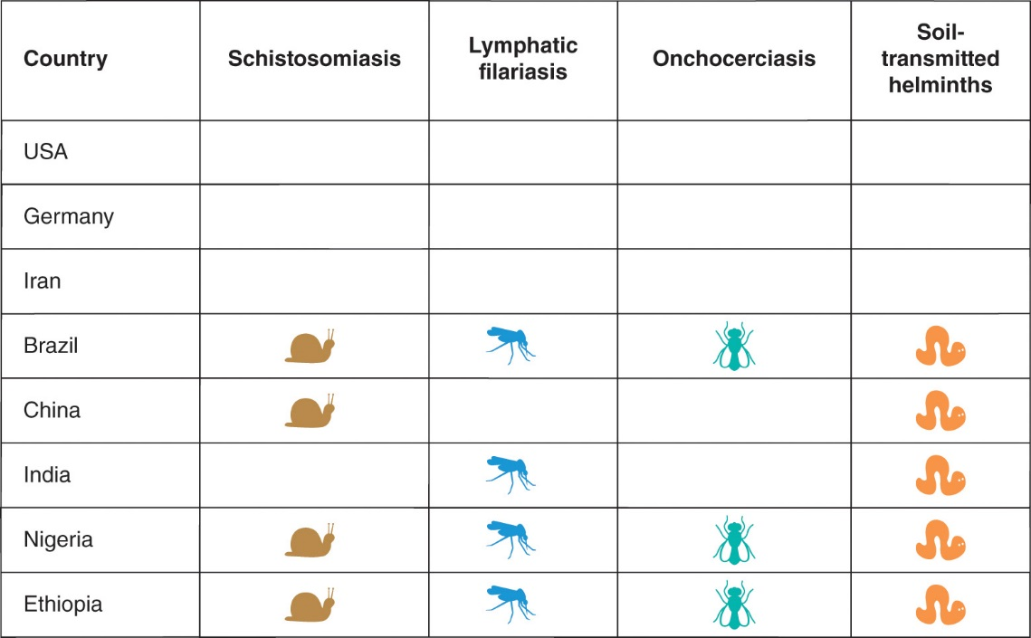
Figure 10-8
Data from Investing to overcome the global impact of neglected tropical diseases: 3rd WHO report on neglected tropical diseases. Geneva: WHO; 2015.
Use of mass drug administration for helminth diseases in featured countries.

Slide 60
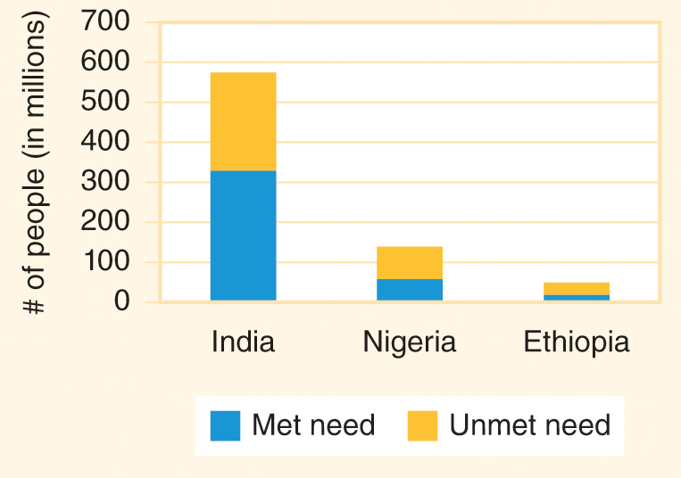
Figure 10-9
Data from Preventive chemotherapy for helminth diseases: Progress report, 2014. Wkly Epidemiol Rec. 2016; 91:93-103.
Many of the people in featured countries who would have benefitted from participation in MDA programs did not receive preventive chemotherapy for an NTD in 2015.

Slide 61
Other Neglected Tropical Diseases (NTDs)
10.14

Slide 62
Other NTDs
Taenia solium = a tapeworm that undergoes early development in the muscle tissue of pigs (its intermediate host) and then matures in the intestines of humans (its definitive host) who consume undercooked pork containing T. solium larvae.
  Taeniasis = these tapeworms being present in human intestines.
  Cysticercosis = the disease caused by the helminths forming cysts in muscle tissue or other parts of the body.
  Neurocysticercosis = T. solium larvae (cysticerci) trigger epileptic seizures and other problems associated with brain lesions.

Slide 63
Other NTDs (cont’d)
Echinocococcus granulosus = a tapeworm with a lifecycle that requires an early developmental stage in sheep (or other livestock, such as cattle, goats, or pigs, that serve as an intermediate host) followed by maturation in dogs (the definitive host).
  Echinococcosis = disease in humans, who are accidental hosts who occasionally become infected from contact with dogs.
  Hydatid cyst disease = the larvae cause cysts in the liver and lungs, a life-threatening condition.

Slide 64
Other NTDs (cont’d)
Yaws causes skin lesions and bone and cartilage damage that may be disfiguring if the infection is not treated with a single dose of antibiotics.
  Treponematosis = an infection with bacteria from the Treponema genus.
Mycetoma = Madura foot = a chronic granulomatous inflammatory disease of the subcutaneous tissue of the foot (or other body part).
Four foodborne diseases caused by trematodes–clonorchiasis, opisthorchiasis, fascioliasis, and paragonimiasis—are contracted from undercooked fish, seafood, and other foods.

Slide 65
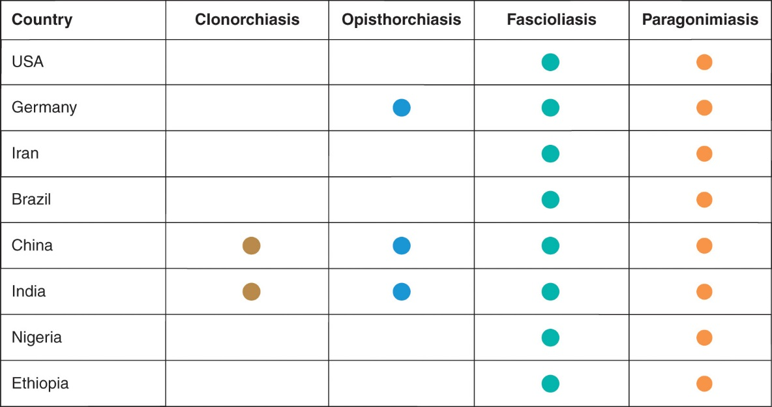
Figure 10-10
Data from Investing to overcome the global impact of neglected tropical diseases: 3rd WHO report on neglected tropical diseases. Geneva: WHO; 2015.
Presence of foodborne trematodiases.

Slide 66
Eradication
10.15

Slide 67
Eradication Vocabulary
Control = to use public health interventions to reduce the incidence or prevalence of a condition within a community or a larger geopolitical area.
Elimination = the use of control measures to remove all risk of new infection in a defined geopolitical area.
Eradication = there is no risk of infection or disease anywhere in the world, even in the absence of immunization or any other control measures.
Extinction = an agent no longer exists in nature or in the laboratory.
The only infectious disease eradicated thus far is smallpox, a viral disease that caused scarring blisters to form over the body, starting on the face then appearing on the extremities and later showing up on the trunk.
Two diseases are far along in the process toward eradication: dracunculiasis and polio.

Slide 68
Dracunculiasis
Dracunculiasis = guinea worm disease.
People contract the guinea worm (Dracunculus medinensis) by drinking water that contains water fleas infected with worm larvae.
A mature female guinea worm may grow inside the subcutaneous tissues of the body to nearly 3 feet in length.
Once the worm is mature, it forms a painful blister on the skin, which ruptures to allow the worm to emerge from the body over several weeks.
People with an emerging worm can contaminate drinking water supplies with eggs and start the cycle of infection over again.
There is no drug for dracunculiasis and no vaccine.
An eradication campaign led by the Carter Center promotes filtering of drinking water, tracks cases, and provides patient and community health education.
The number of cases of guinea worm disease diagnosed each year has dropped from an estimated 3.5 million cases in 1986, prior to the start of the eradication program, to less than 100,000 per year by 1997 to just 22 in 2015.

Slide 69
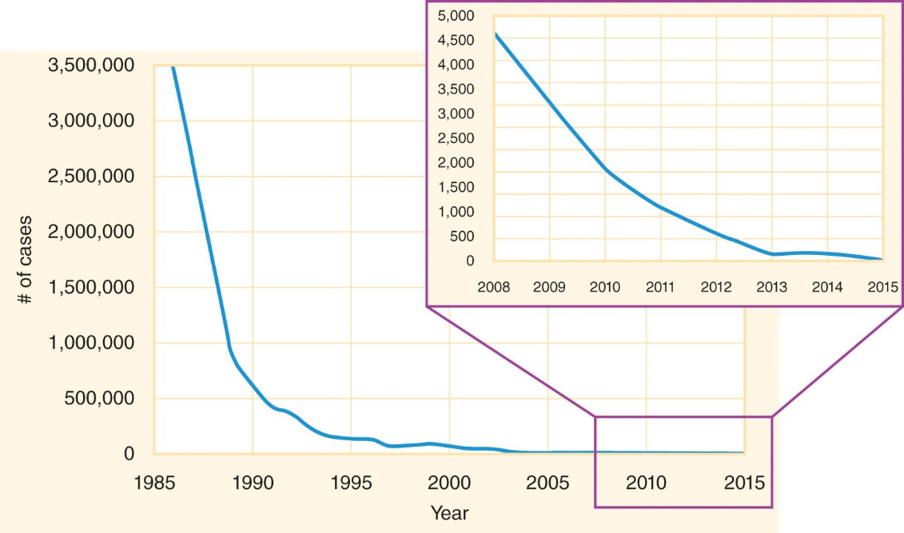
Figure 10-11
Data from Eradication of guinea worm disease: Case statement. Atlanta, GA: The Carter Center/WHO; 2016.
Number of cases of guinea worm globally each year.

Slide 70
Polio
Polio = poliomyelitis = infantile paralysis = a vaccine-preventable disease caused by infection with poliovirus.
About 1 in 200 people who contract poliovirus develop a condition called acute (sudden-onset) flaccid paralysis; some are left with permanent disabilities.
The Global Polio Eradication Initiative (GPEI) was launched in 1988 and aimed to eradicate polio by 2000.
  Before the launch of the GPEI, more than 350,000 children in more than 125 countries were paralyzed by polio every year.
  In 2016, fewer than 100 cases of paralysis occurred worldwide and only three countries were endemic: Afghanistan, Pakistan, and Nigeria.
Sustained effort for many more years will be required to eradicate polio and permanently protect children from the risk of polio-induced disability.

Slide 71
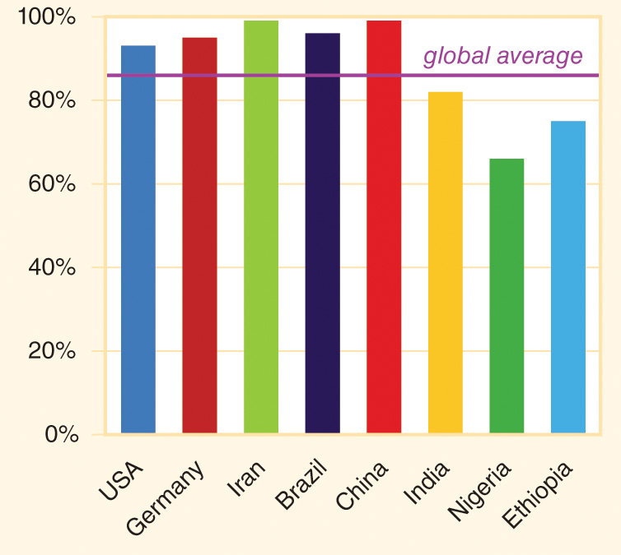
Figure 10-12
Data from State of the world’s children 2016. New York: UNICEF; 2016.
Percentage of infants receiving three doses of polio vaccine.

Slide 72
Emerging Infectious Diseases (EIDs)
10.16

Slide 73
Emerging Infectious Diseases
Emerging infectious disease (EID) = a new pathogen begins to affect human populations or an existing pathogen changes the kind of disease it causes.
EIDs derive from a complex interaction of genetic and biological factors; physical environmental factors; ecological factors; and social, political, and economic factors.
Identifying and taking steps to control emerging threats to human health no matter where they first occur is an important part of protecting the health of all of the world’s people.

Slide 74
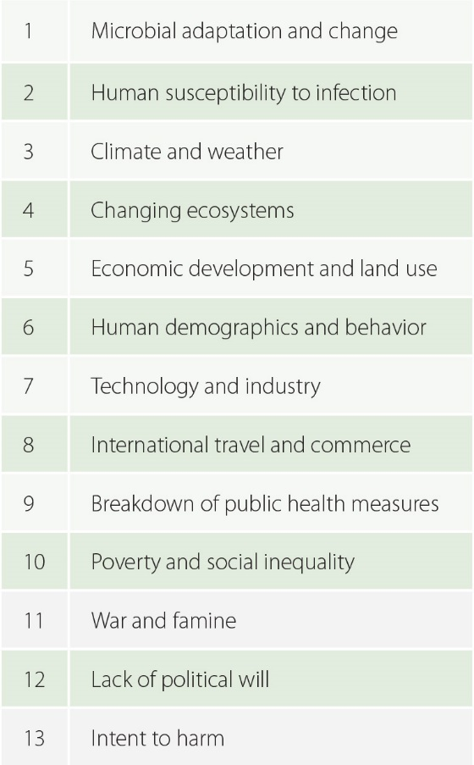
Figure 10-13
Data from Smolinski, MS, Hamburg MA, Lederberg J, editors. Committee on Emerging Microbial Threats to Health in the 21st Century. Institute of Medicine. Microbial threats to health: Emergence, detection, and response. Washington: The National Academies Press; 2003.
Risk factors for EIDs as identified by the U.S. Institute of Medicine.

